Slide 1

Fall Seminar 2024
Diploma Years

Slide 2
Senior Year Timeline
Take a fall SAT/ACT if needed for test scores for Nov/Jan deadlines
Attend any info workshops or meetings held at school
Narrow down college list
Begin applying to colleges
Stay organized with deadlines
Request transcripts and LORs be sent through Naviance
Bright Futures,
Pinellas Ed Foundation
open October 1
FAFSA opened Dec 1
Attend any financial aid workshops offered by district or local universities
Send test scores through testing agencies
Make a college decision and secure your spot by paying your deposit

Slide 3
College Research - Where do They want to go?
Xello!
Florida Shines - www.floridashines.org
Big Future Collegeboard - www.bigfuture.collegeboard.org
eCampus Tours - ecampustours.com
Admittedly - admitted.ly
Cappex - cappex.com
Chegg - chegg.com
College Raptor- collegeraptor.com
Is this college a good fit for me?
  Do they have my major?
  SAT?
  ACT?
  GPA?
  LOCATION?
  Is the price tag realistic?
  What is their 4 year graduation rate?
  What is their avg freshman retention rate?
  Are there options for study abroad?
  Are their students employed upon graduation?

Slide 4
College Application Process
Apply directly through the college/university website
Common Application - commonapp.org
Xello – HAVE TO CONNECT TO COMMON APP
Coalition Application
SendEDU
Military
Trade
Transcripts
Letters of Recommendation - who to pick
SSAR
Deadlines

Slide 5

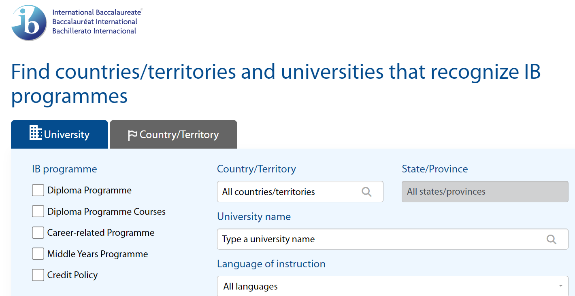
IB Resource to research colleges and the IB
https://recognition.ibo.org

Slide 6
College Admissions-Applications
There are various ways to apply
All students must connect Xello to Common App
If student not applying through Common App they still MUST add college to Xello college list
Step by step video for Xello/Common App linking:
https://tinyurl.com/ywb9yx2z

Slide 7
Xello
Search for Best Fit Colleges
Request Counselor Recommendations/School Report
Request Transcripts
Request Letters of Recommendations from Instructors
Track application documents for all applications
We have connected Common App and Naviance alread

Slide 8
SAT – collegeboard.org
2 sections
Scoring - range 200-800
Fee Waiver
Superscoring
Critical Reading & Writing
Math
800 max
total is 1600

Slide 9
ACT – act.org
4 sections
Scoring - Range
1-36
Each section gets scored
Composite = all sections averaged together
Super scoring
Fee Waiver
English, Math, Reading, Science
**Science will go optional in April/September 2025
Bright Futures will still require Science (as of right now)

Slide 10
SAT vs ACT
SAT is fully digital (and adaptive), ACT is going digital but still have choice for paper/pencil (for now)
Some colleges are test optional
Some say ACT caters a bit towards general academic strengths
SAT gives slightly more time per question than ACT.
Neither penalizes for wrong answers, so you should always give your best guess!
Neither measure intelligence – just how well you do at taking this company’s test

Slide 11
SAT vs ACT
Sign ups for both are done through the testing agency.
Fee Waivers are available for students on free/reduced lunch: 2 waivers each lifetime
Test Blind: these schools won’t look at test scores AT ALL.
Test Optional: consider test scores. Check the middle 50% range of scores… if you scored in this range or higher, then submit.
Superscoring: taking the highest score of each section to total your highest composite scores

Slide 12
Miscellaneous info
IB Padlet: https://padlet.com/shepherda5/t90ztc16h0jqe5fq
College days
College lists
Remind
Emails
Website, usernames, passwords
College Visits at PHU

Slide 13

BRIGHT FUTURES
Floridastudentfinancialaid.org
Application opens October 1st and ends at graduation

Slide 14
BRIGHT FUTURE SCHOLARSHIPS
FLORIDA ACADEMIC SCHOLARSHIP
FLORIDA MEDIALLION SCHOLARSHIP
3.5 GPA
29 ACT
1330 SAT
100 Hours
3.0 GPA
25 ACT
1210 SAT
75 hours

Slide 15
IB Diploma
Bright Futures Academic Scholarship
Notes:
Shepherd-Thompson

Slide 16
The IB Core
Creativity-Activity-Service
Students MUST update Managebac by the end of each month
Theory of Knowledge
Extended Essay
Is your student on track?
Exhibition Completed Junior Year
Paper completed Senior Year
Final drafts and Viva Voce (last meeting with advisor) need to be been turned in/completed in Managebac by 10/13/23.
Notes:
Tancrell/Kluis

Slide 17
The IB Core - TOK
An interdisciplinary course that examines the nature of knowledge and the human capacity for thought and understanding
Critical is questioning how one knows what one claims to know; how does one properly justify that which is believed true
Students challenge their own held notions and underlying (unquestioned) assumptions
Address knowledge issues (AOKs)
Notes:
Tancrell/Kluis

Slide 18

The IB Core - TOK
TOK Exhibition – assesses the ability of the student to show how TOK manifests in the world around us.
TOK Essay – students explore TOK in one of the six given titles.
TOK assessments are neither an essay nor a report on a topic. Students must deeply examine the “Knowledge Questions.”
Notes:
Kluis

Slide 19
The IB Core - CAS
Creativity-Activity-Service
Divided among the three areas
Planned (approved)
Activities carried out continuously over time
Documented; evidenced
Signed off by an objective adult supervisor
Required interviews and reflection
Final review by IB CAS Coordinator
Notes:
Kluis

Slide 20
The IB Core Extended Essay
RESEARCH
INVESTIGATION
ACADEMIC INQUIRY
Reasoned examination of an intellectual nature in which established sources of academic merit are assessed and applied in the creation of authentic writing
Students have turned in their draft and should have arranged an appointment to receive feedback from their advisor
Once they’ve received feedback, revised and submitted final, they must meet with their advisor one last time for their Viva Voce
Notes:
Kluis

Slide 21
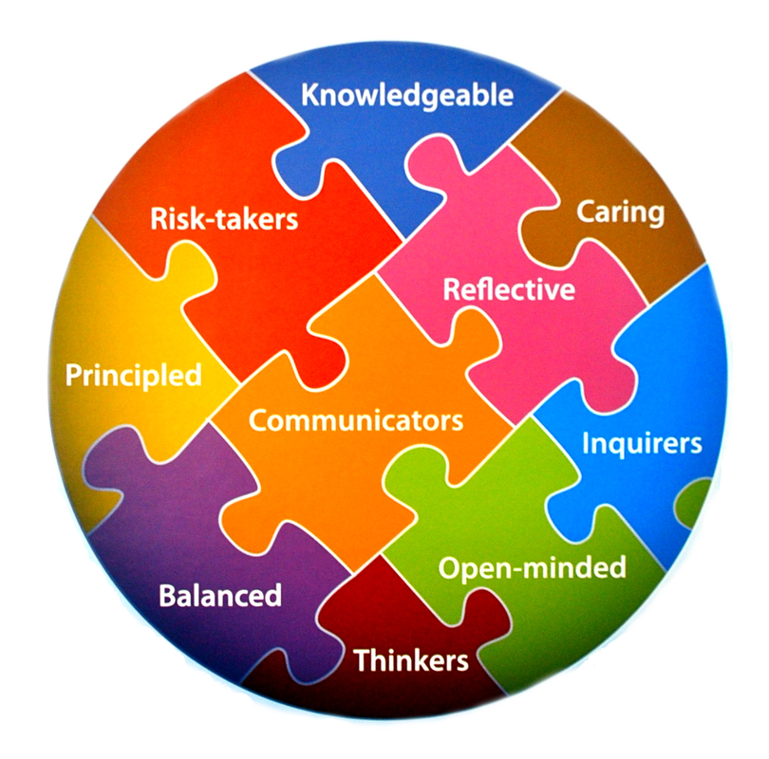
Critical Concept
    CAS
    TOK
    EE
    DP Courses
These are an integrated whole in developing ourselves with the attributes of the IB Learner Profile
Notes:
Tancrell/Kluis

Slide 22
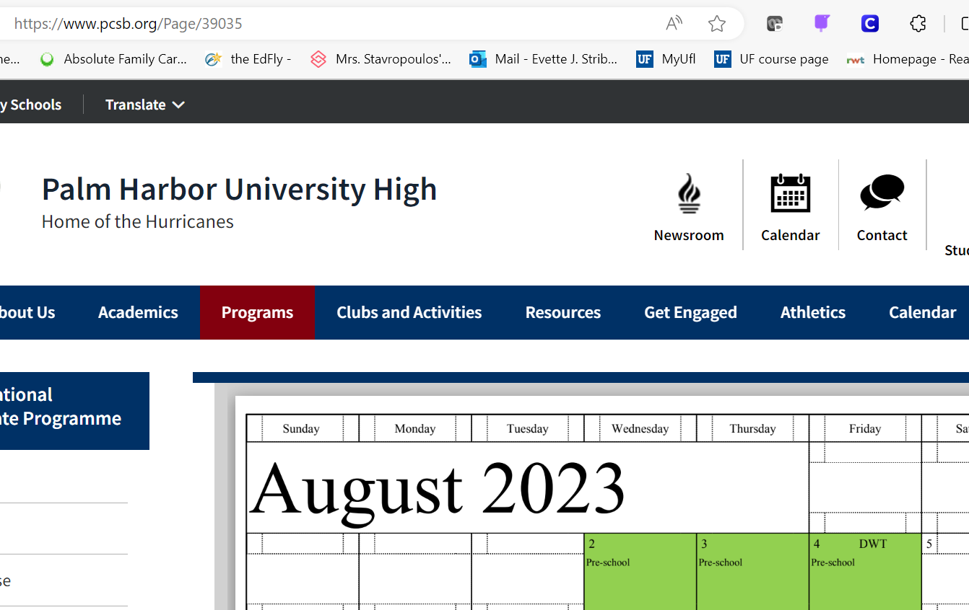
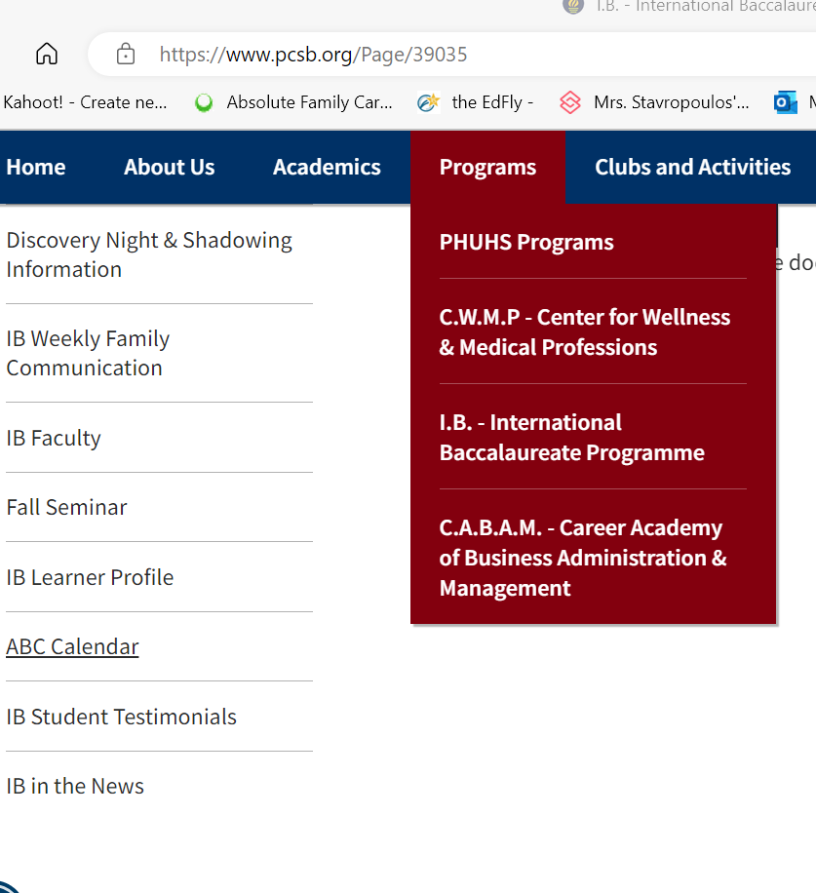
Important Dates: Check Website ABC Calendar
Notes:
Striblen

Slide 23


Earning the IB Diploma
Palm Harbor University High School

Slide 24
The Diploma Years:
Approaches to Teaching and Learning
View yourself as a college student
Bring your best game every day
Approaches to Teaching and Learning
Theoretical understanding to analyze and evaluate
Deep knowledge to put forth and debate assertions
Explain richly from divergent viewpoints
Notes:
Striblen

Slide 25
The Diploma Years:
Approaches to Teaching and Learning
Study for depth of understanding and connections among concepts that may not immediately appear related
Each course is vital – You cannot sacrifice one for another
Managing your time is critical. Use a calendar and have a plan for all assignments and assessments
Notes:
Striblen

Slide 26

Learning Goal
What are the regulations and score requirements for me to earn the IB Diploma?
Notes:
Striblen

Slide 27
What do you know?
What elements make up the Diploma calculation?
What is the score scale for IB courses?
What is the score scale for EE & TOK?
What’s the score in an IB course that puts a person out of the running for the Diploma?
What’s the score EE or TOK that puts a person out of the running for the Diploma?
Notes:
Striblen

Slide 28
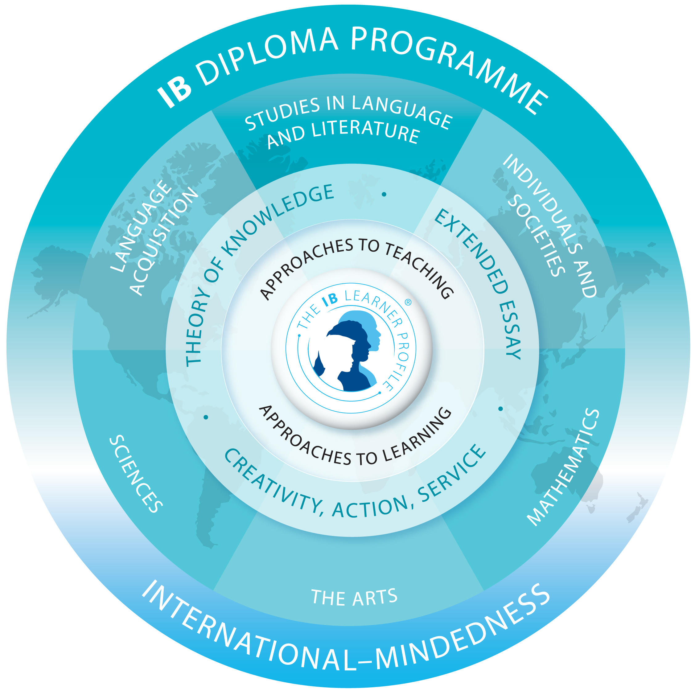
Earning the IB Diploma: Elements
All course and point requirements PLUS
You cannot earn the IB Diploma without
Theory of Knowledge
Extended Essay
CAS
Creativity-Activity-Service
These are also graduation requirements!
Notes:
Striblen

Slide 29
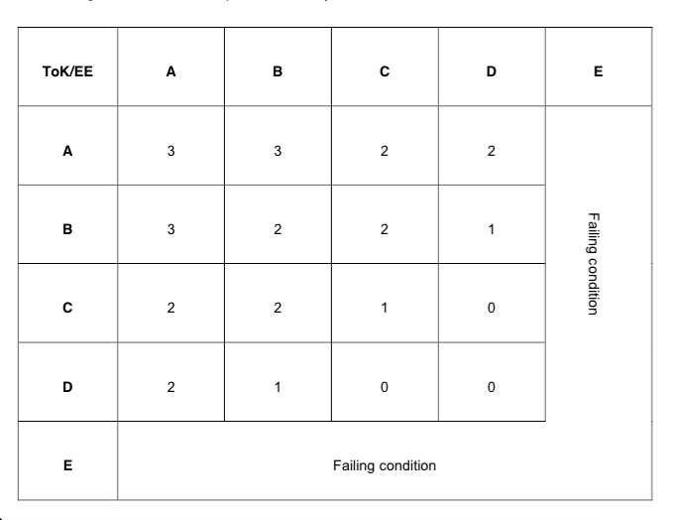
EE / TOK Matrix Bonus
TOK Exhibition & Paper
Extended Essay
(Source: IBO, Simplifying the Diploma Requirements 2014)
Notes:
Striblen

Slide 30
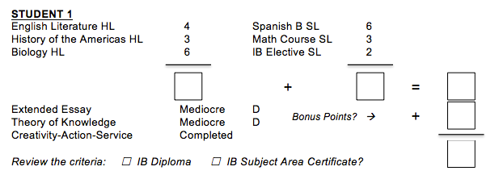
Student 1

Slide 31
Student 1
13
11
24
0
24
✔
Solution: IB Diploma

Slide 32
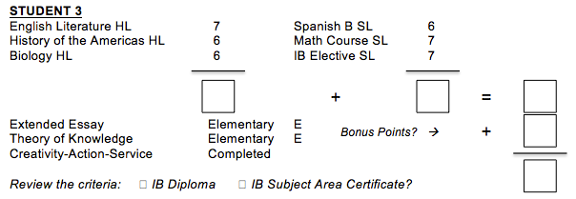
Student 2

Slide 33
Student 2
19
20
39
FC
39
✔
Solution: IB Subject Area Certificate (Failing Condition)

Slide 34
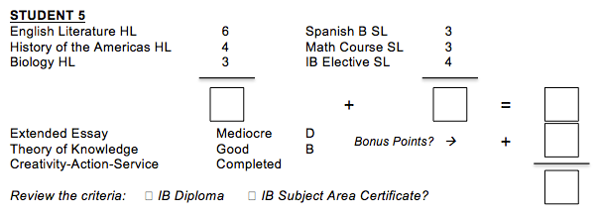
Student 3

Slide 35
Student 3
13
10
23
1
24
✔
Solution: IB Diploma

Slide 36
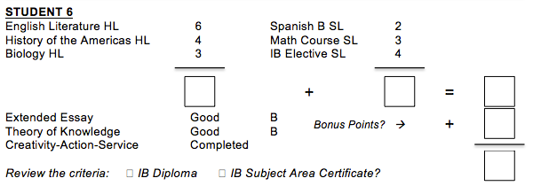
Student 4

Slide 37
Student 4
13
9
22
2
24
✔
Solution: IB Diploma

Slide 38
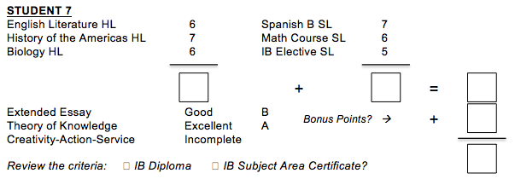
Student 5

Slide 39
Student 5
19
18
37
3
40
✔
Solution: IB Subject Area Certificate (CAS Not Met)

Slide 40
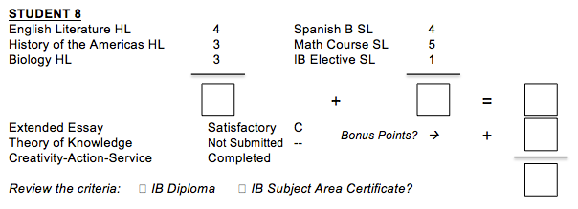
Student 6

Slide 41
Student 6
10
10
20
N
20
✔
Solution: IB Subject Area Certificate (<24 points N for TOK Score of 1)

Slide 42
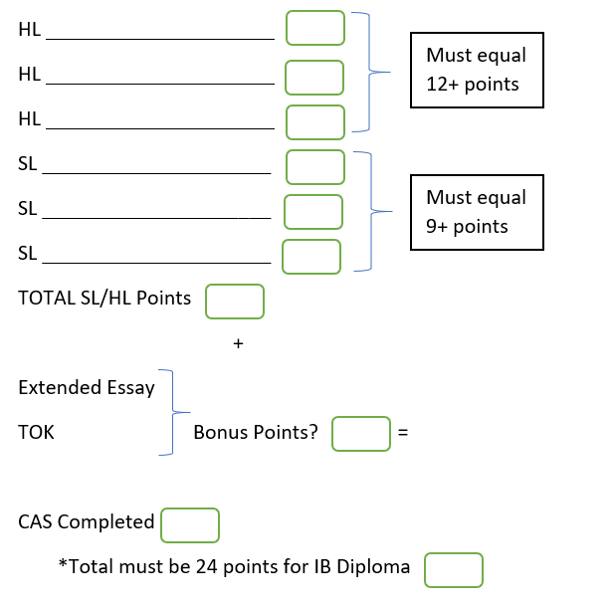
What about your student?
Help them predict…
Notes:
Striblen

